Slide 2
Presentation S1
Supplementary material to the article “Reports of abnormal animal behavior in relation to earthquakes in Colombia” by John J. Sánchez.
Slides 2-7: Maps with the spatial distribution of AAB reports for each taxonomical category.
Slides 8-47: Maps showing the loation of each earthquake epicenter and the corresponding AAB.

Slide 3
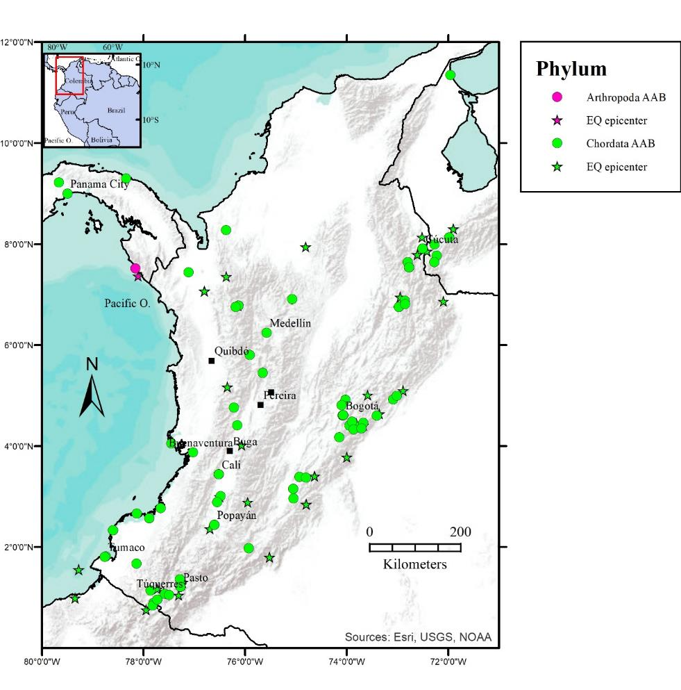

Slide 4
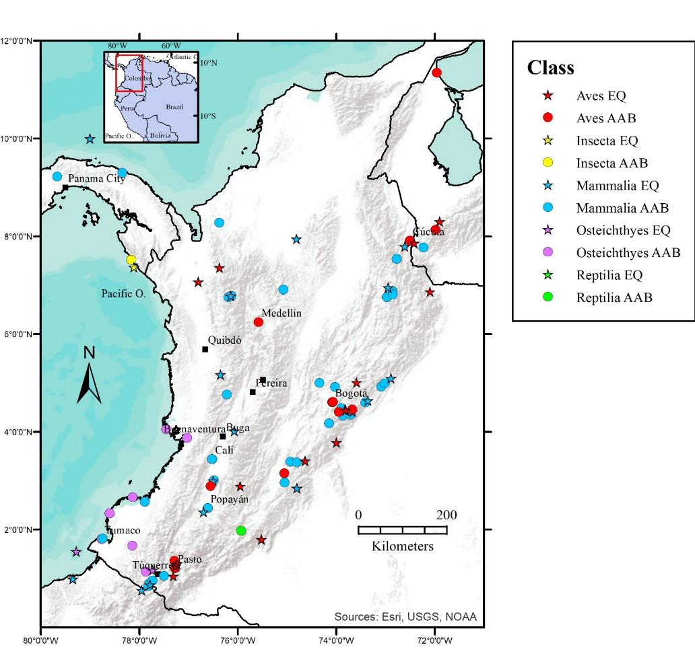

Slide 5
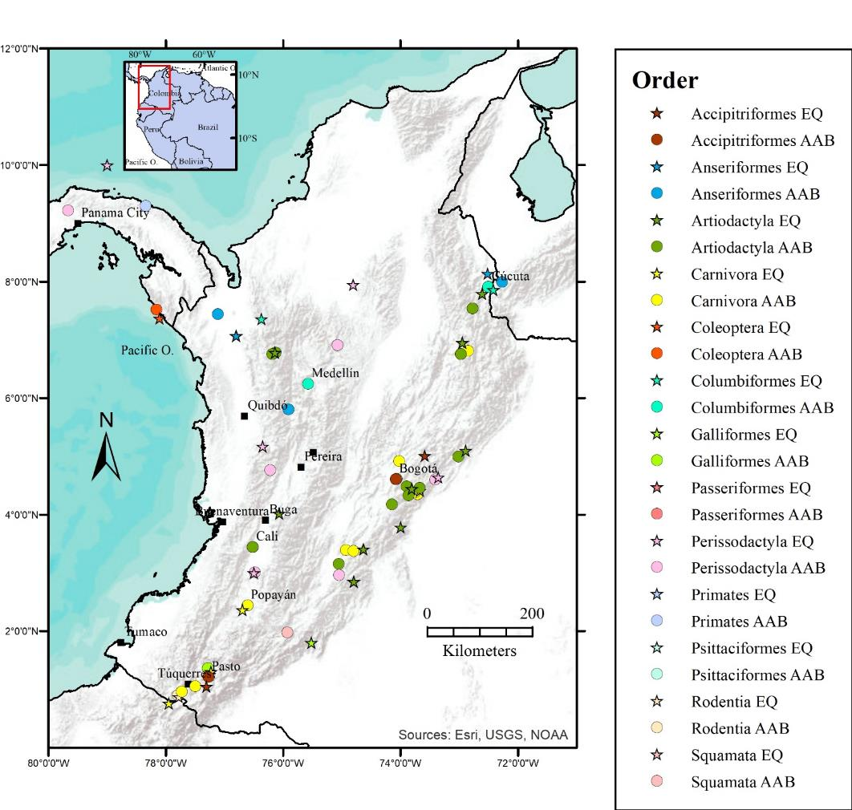

Slide 6
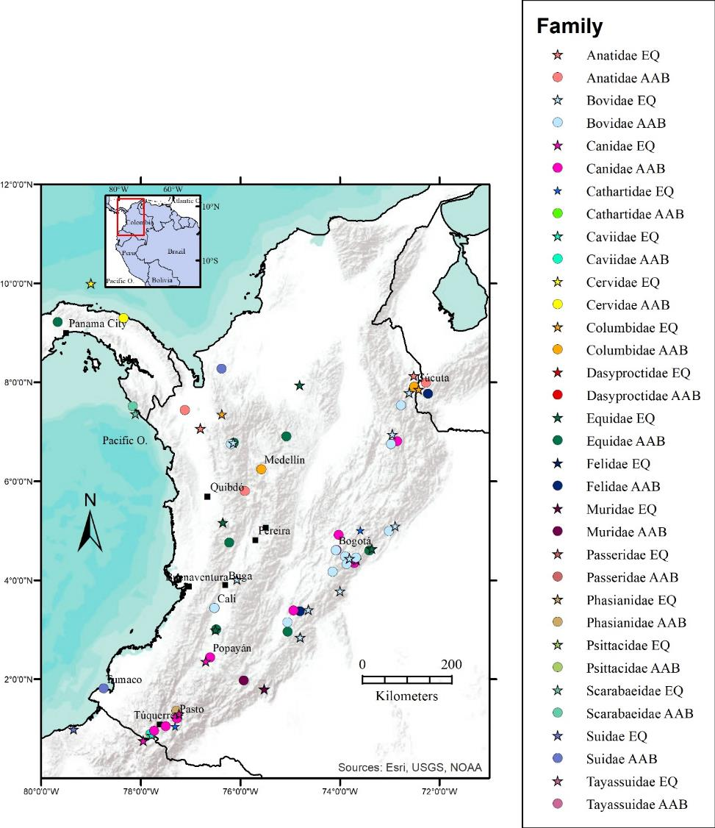

Slide 7
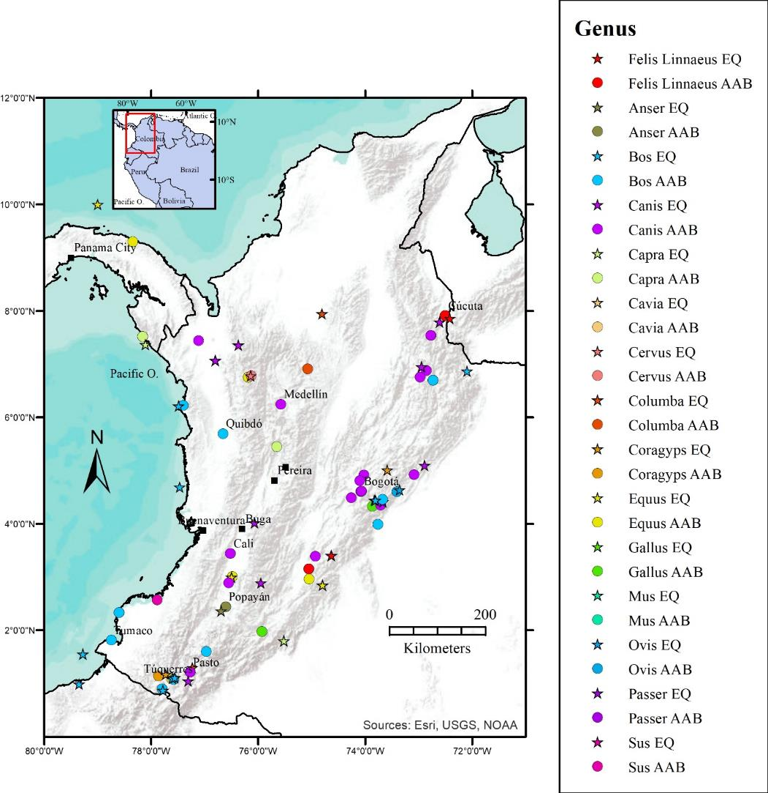

Slide 8
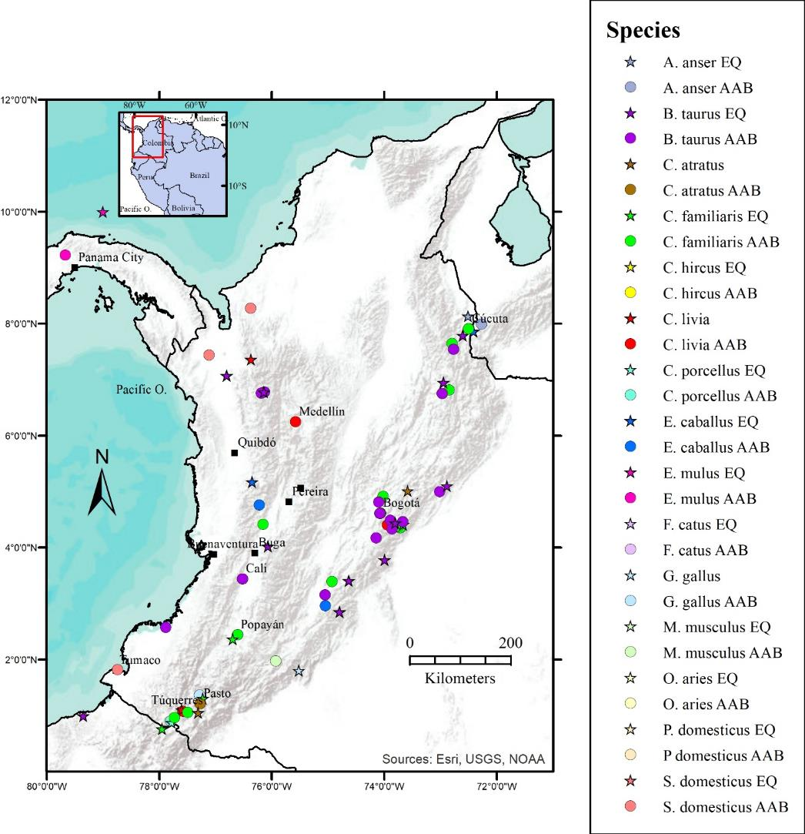

Slide 9
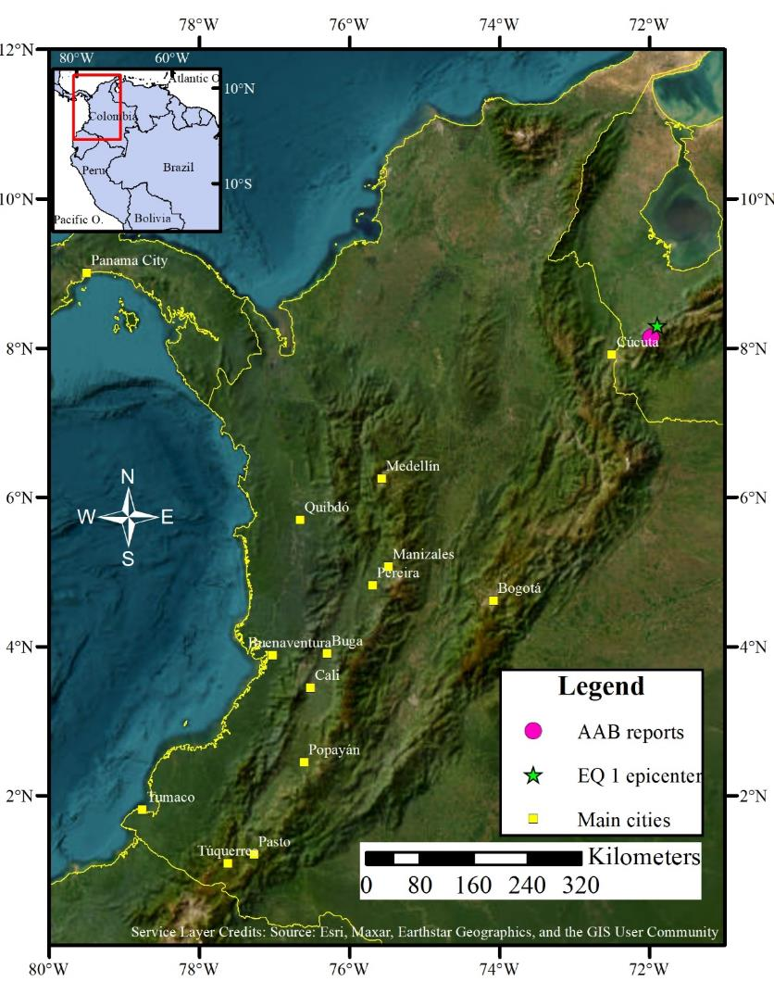

Slide 15
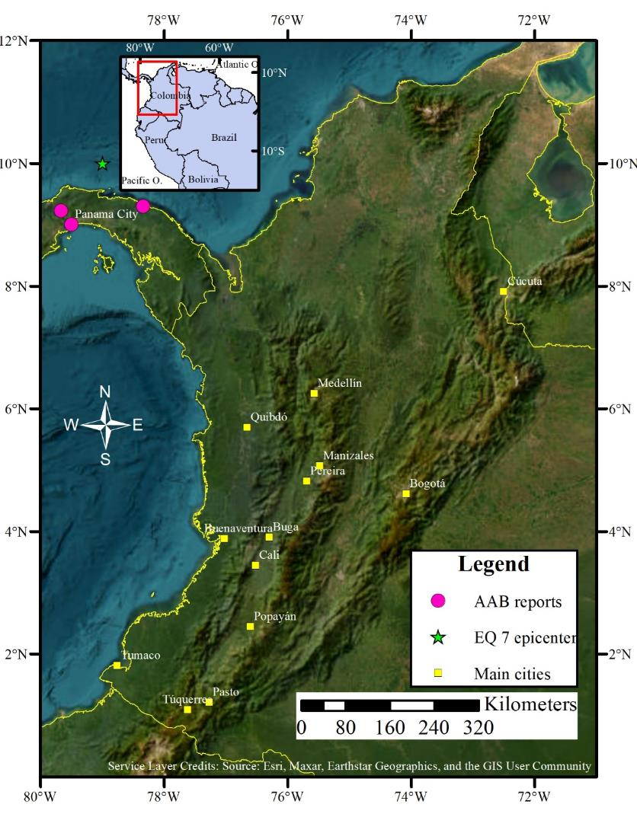

Slide 43
